Slide 1



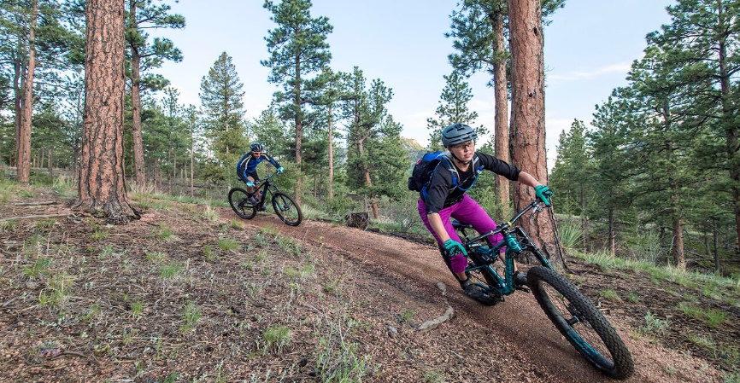
Apple iPhone 7
SignIn
Opening hours:
Mon-fri:9am-8pm
Sat-sun: 8am-6pm
Call us 0123456789
Bike King Borders is a growing company based in the Borders region of Scotland. The company sell and repair road, mountain and hybrid bikes as well as sell a range of bike accessories and clothing. In addition they hire out bikes for daily use on nearby off road bike trails.

Slide 2
PRODUCTS

Slide 3
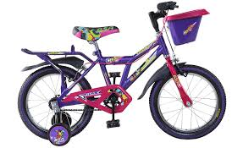
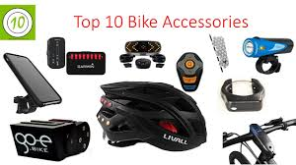
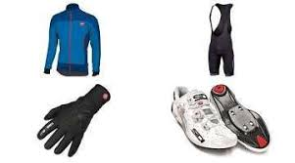
KIDS BIKES
CYCLING CLOTHINGS

Slide 4
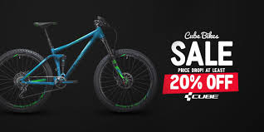
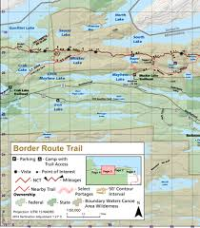



Border route map
Site Map
sales/repairs
clothing
Accessories
Biking King Borders 2019
Register
Home
Contact Us

Slide 5



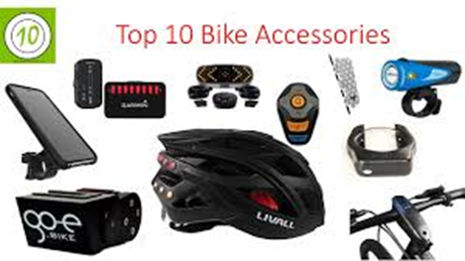



Biking King Borders 2019
Home | services | products | clothing | SignIn | Contact
Apple iPad Air
Opening hours:
Mon- fri: 9am-8pm
Sat-Sun: 8am-6pm
Call us 0123456789
Bike King Borders is a growing company based in the Borders region of Scotland. The company sell and repair road, mountain and hybrid bikes as well as sell a range of bike accessories and clothing. In addition they hire out bikes for daily use on nearby off road bike trails.
Call us 0123456789
SERVICES&REPAIRS
PRODUCTS
CYCLING CLOTHINGS
This Photo by Unknown Author is licensed under CC BY-SA-NC
Border route map
Contact
Home
Services
Contact Us
Register

Slide 7

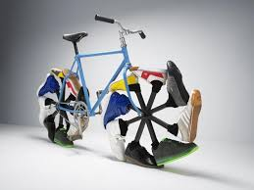
Biking King Borders 2019
Home | services | products | clothing | SignIn | Map
Call us 0123456789
Bike King Borders is a growing company based in the Borders region of Scotland. The company sell and repair road, mountain and hybrid bikes as well as sell a range of bike accessories and clothing. In addition they hire out bikes for daily use on nearby off road bike trails.
Email
News ,Reviews & Features

Slide 8
SERVICES

